Slide 1
Narcovet
Giulia Bleichenbacher
Sarah Deckarm
Leonie Isele
Firat Turan
The solution for automated management of narcotics in veterinary practice

Slide 2
The problem we tackle:
Narcotics require strict documentation
Often no automation and paper based
No clear path of communication
No clear responsibilities defined

Slide 3
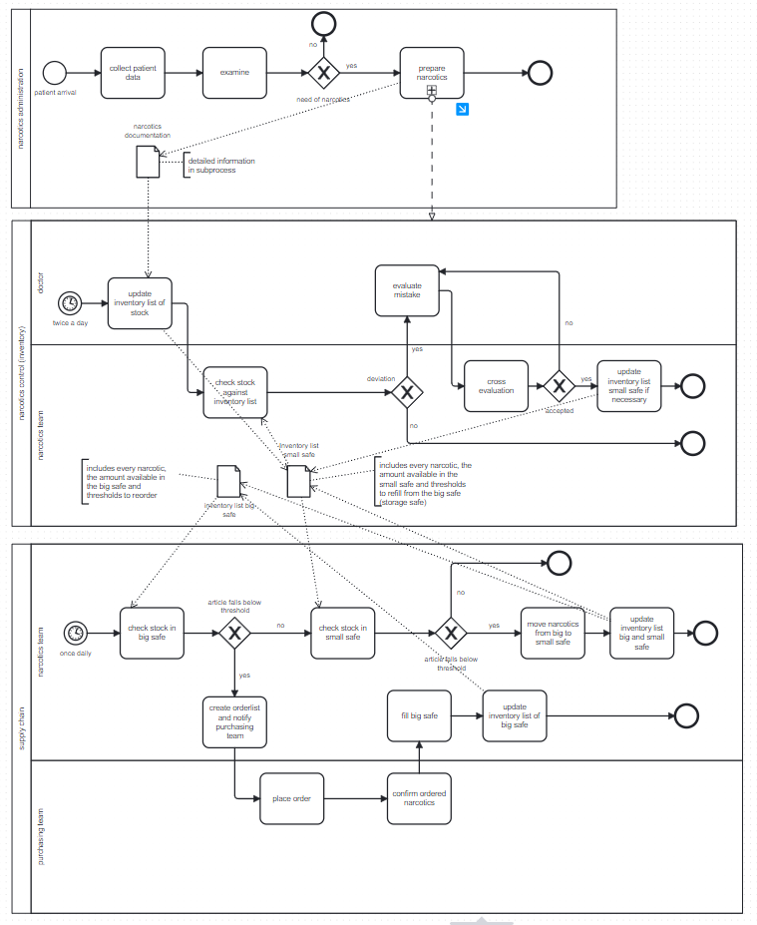
AS IS Process

Slide 4
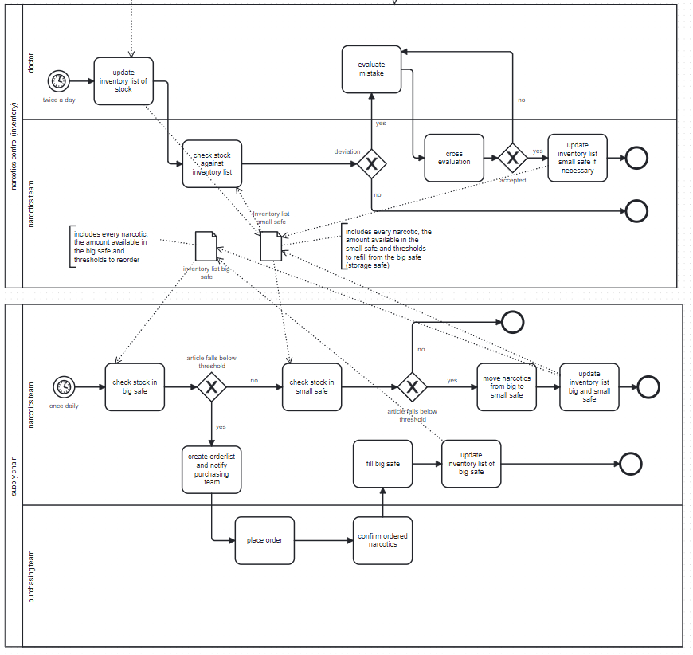
AS IS Process – main process of interest

Slide 5
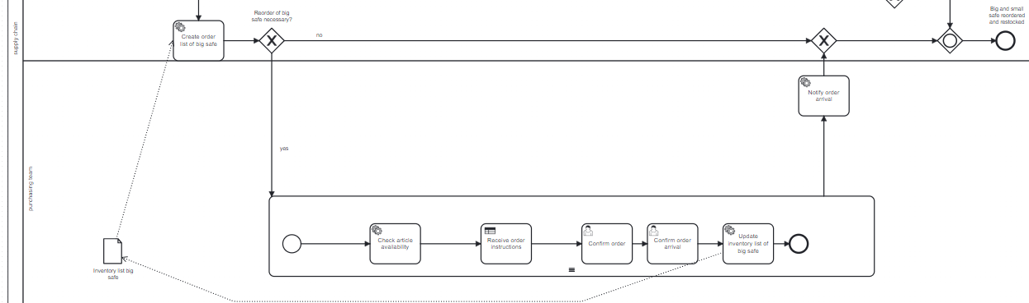
TO BE Process
Notes:
Now to the second path of the process, which automatically reorders items for which the stock is low in the big safe. The process starts with the creation of the service task. This is a process step which automatically determines how which items and how much as to be reordered for each narcotic available. If there are any that have to be reordered the process loops through each item. The first step is always to control if this item is available for reorder. This is implemented with a process task which simulates a real API that returns global drug shortages. Next we have implemented a decision table that reads the response of the API and if necessary returns alternatives to the requested narcotic.
After the process receives the reordering instructions they are presented to a member of the purchasing team. The purchasing has to then confirm that the medication arrived. The quantities in the big safe are updated automatically by a service task.
After this subprocess has finished for all narcotics in the reorder list the narcotic team is notified via email.

Slide 6
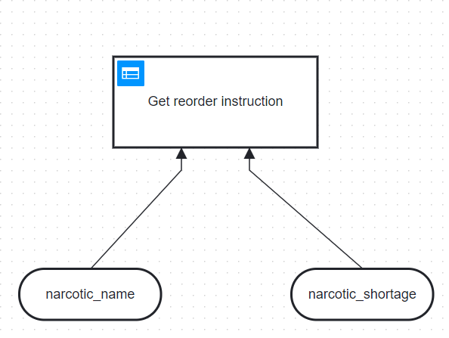
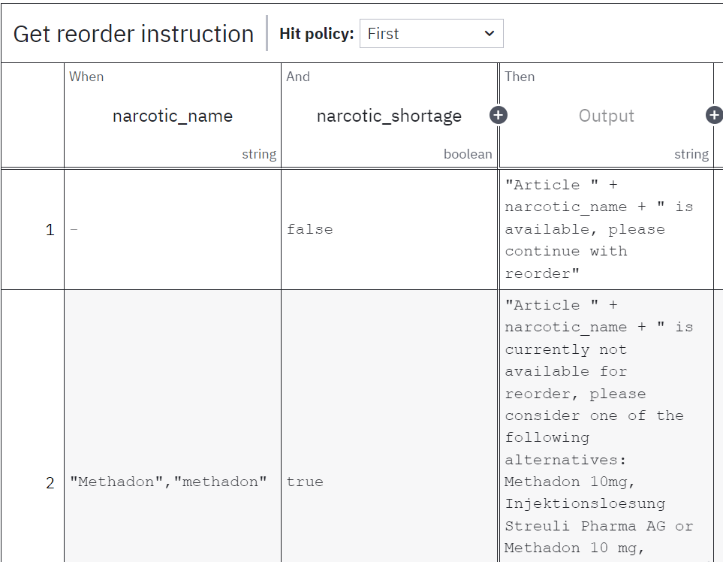
TO BE Process
Notes:
This is what that looks like in detail, we have an input of the narcotic name and whether there is a shortage. If there is no shortage the process gives instructions about reordering the same article. If there is a shortage the decision table proposes alternatives for each narcotic.

Slide 7
The solution we provide
Automation:
inventory is checked as time event automatically
Returns if threshold is under or over the limit
Unification
Decision support
Use of Camunda, Python,
Multiple service tasks, Decision modeling
Notes:
One big advantage is that this process is automated, meaning that we have implemented a cron pattern that starts the process daily at 11:00 without a team member having to think about it. The narcotics team is then only informed if there is something for them to do.
For technologies we have decided to keep it simple, so as i just showed you we have the Decision Support Table, we have the camunda process and we have multiple service tasks that were implemented in python using a Flask API.
We are also sending emails in this API, for sending those we use the python smtplib library

Slide 8
Demonstration
Let us show it to you in a video

Slide 9
Benefits
Narcotics management
Reduction of hours:
180h per year without Narcovets
67h per year with Narcovets
Reduction of expenses:
10.000CHF per year without Narcovets
5.000CHF per year with Narcovets
Cherry on top:
Centralized documentation
Less risk for human errors or human intervention for misuse

Slide 10
Conclusion
Problems
Solutions
Exlusively paper based
No automation
Unclear responsibilities
Time consuming
No decision support for alternative medications
Inventory list: digitalized
Automated e-mail generation
For order arrival
Threshold warning
Decision logic implemented to enable quick access to alternative medications

